Slide 1
Data Science and Artificial Intelligence Project
Datasets from Kaggle
SC9 Team 5:
Lim Jia Earn
Jeff Tan
Tan Kai Boon

Slide 2
Problem Formulation
Problem Definition

Slide 3

Problem Definition
Classification Problem:
Are we able to predict how(number of days) long a youtube video is trending based on its attributes?
Which machine learning model will be best in predicting it?
Dataset used:
Trending Youtube Video Dataset from

Slide 4
Data Analysis
Using plots to assist us in identifying patterns

Slide 5
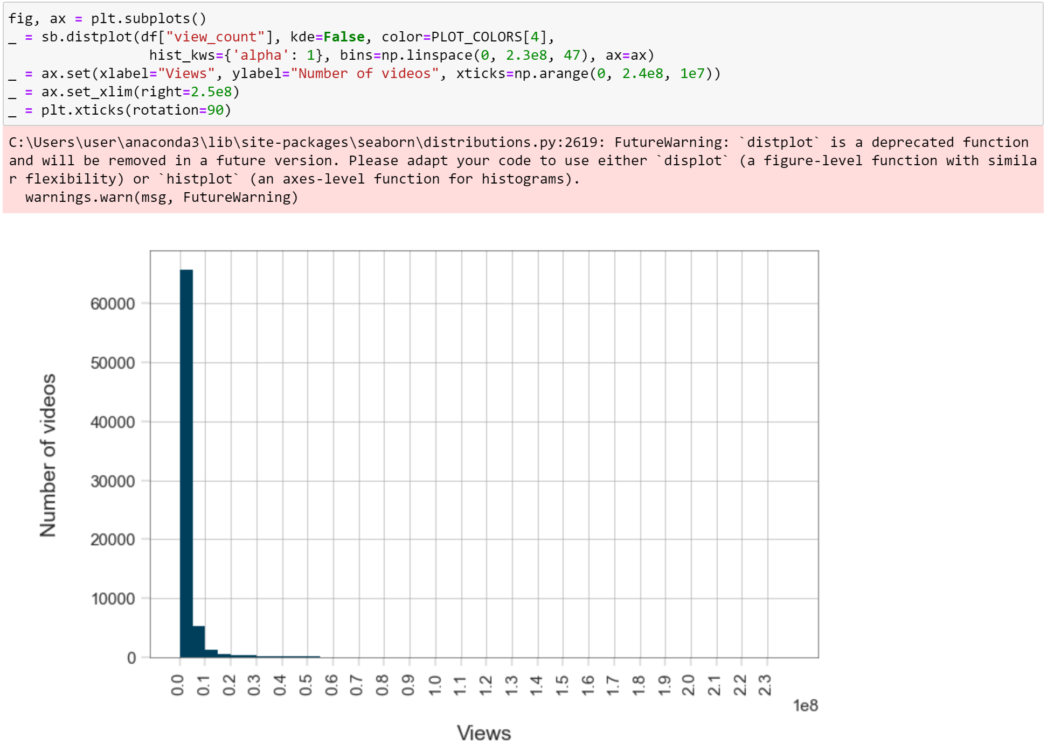
Numeric Variables (Views)
Distribution is heavily skewed to the left
40% of trending videos less than million views

Slide 6
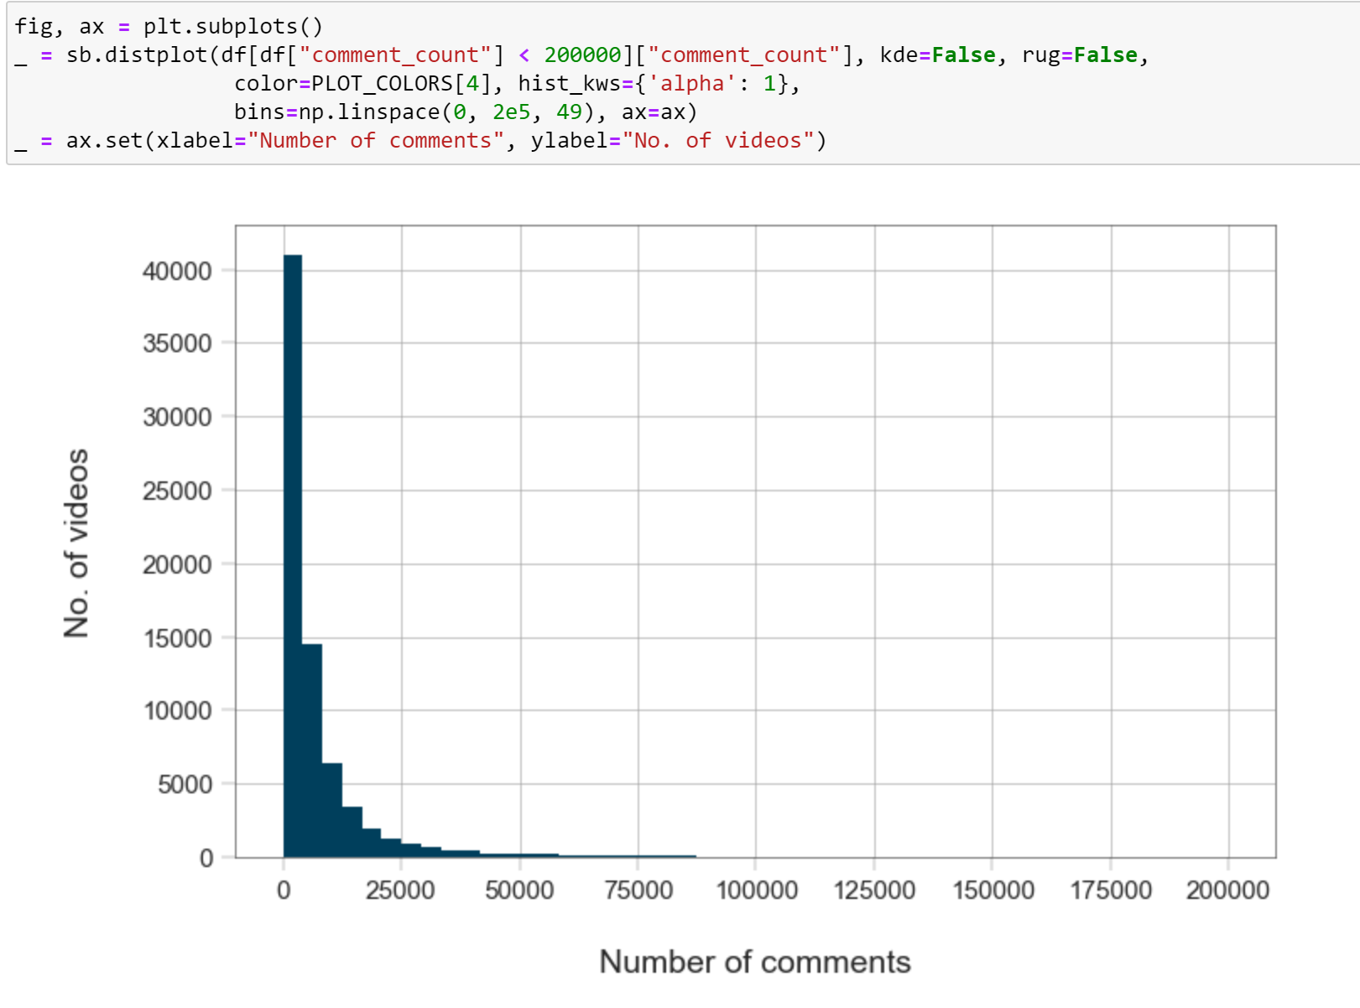
Numeric Variables (Comments)
Similar distribution to views
About 80% of trending videos’ comment count is below the average

Slide 7
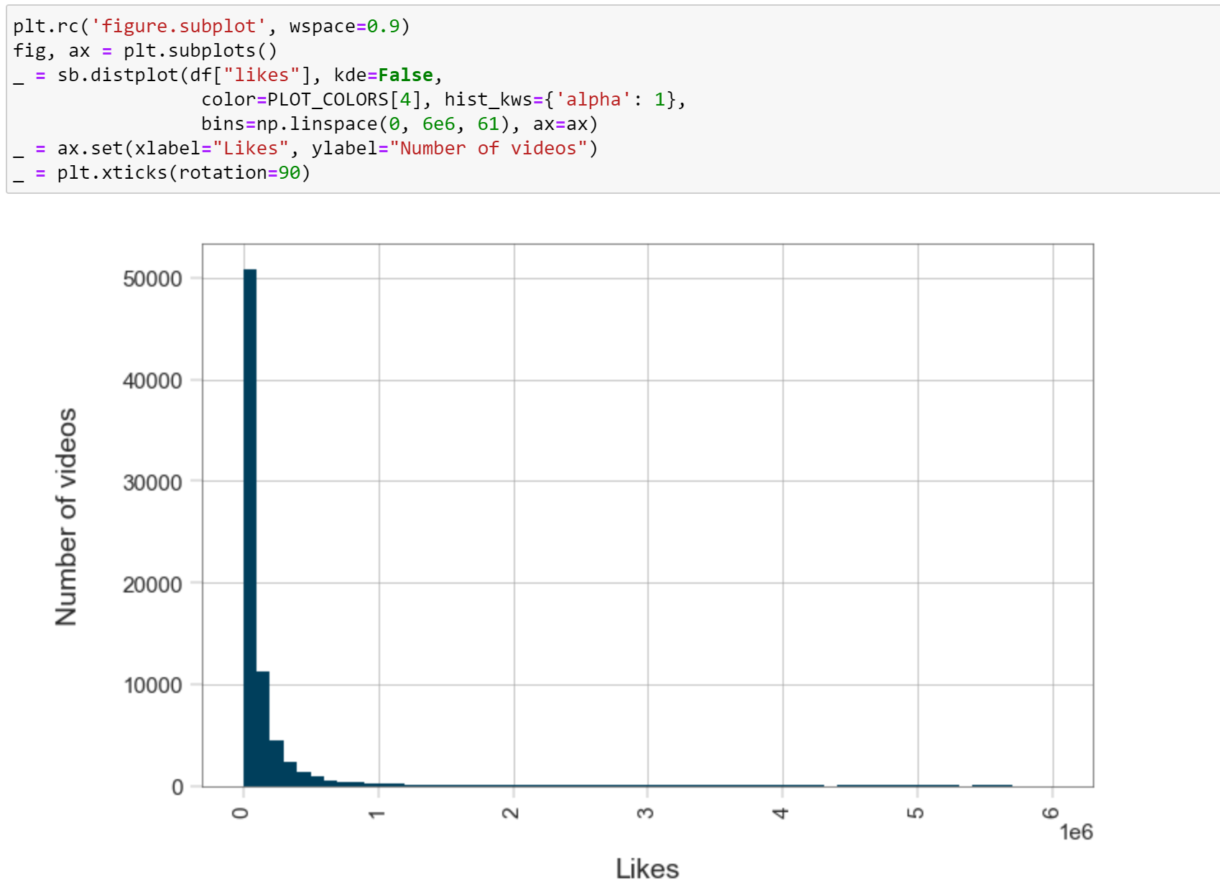
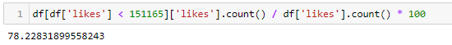
Numeric Variables (Likes)
Similar to previous distributions
About 80% of data fall below the mean likes

Slide 8
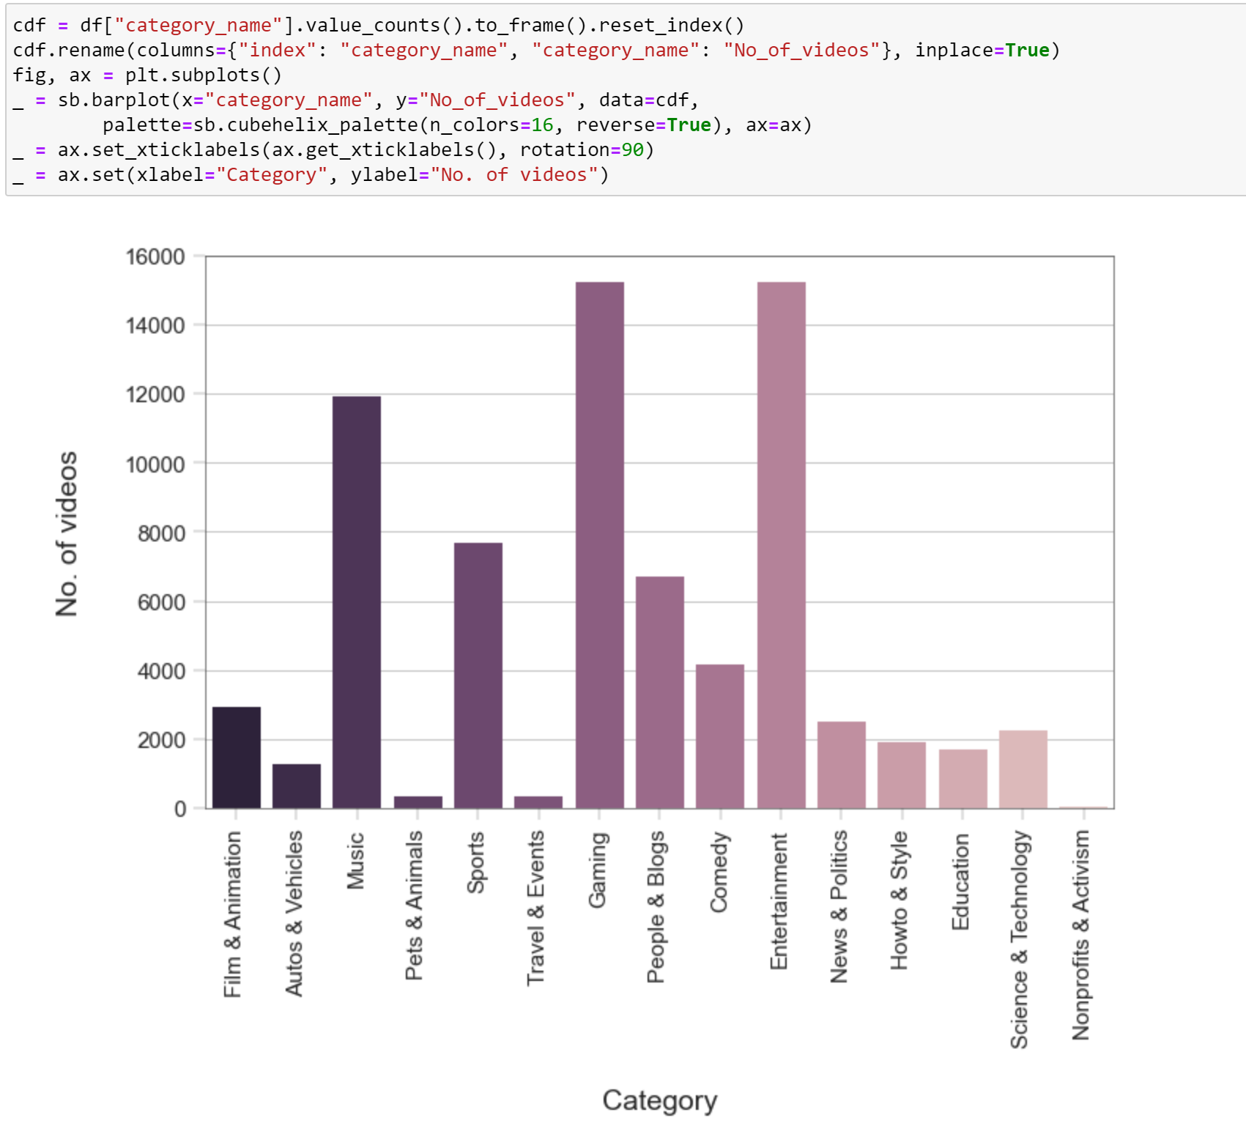
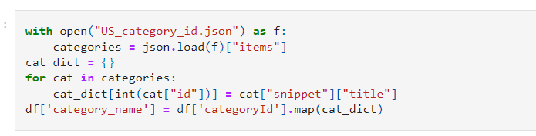
Non-numeric Variables (Categories)
Different categories have fairly distinctive trending videos count
Might be useful when doing classification tree

Slide 9
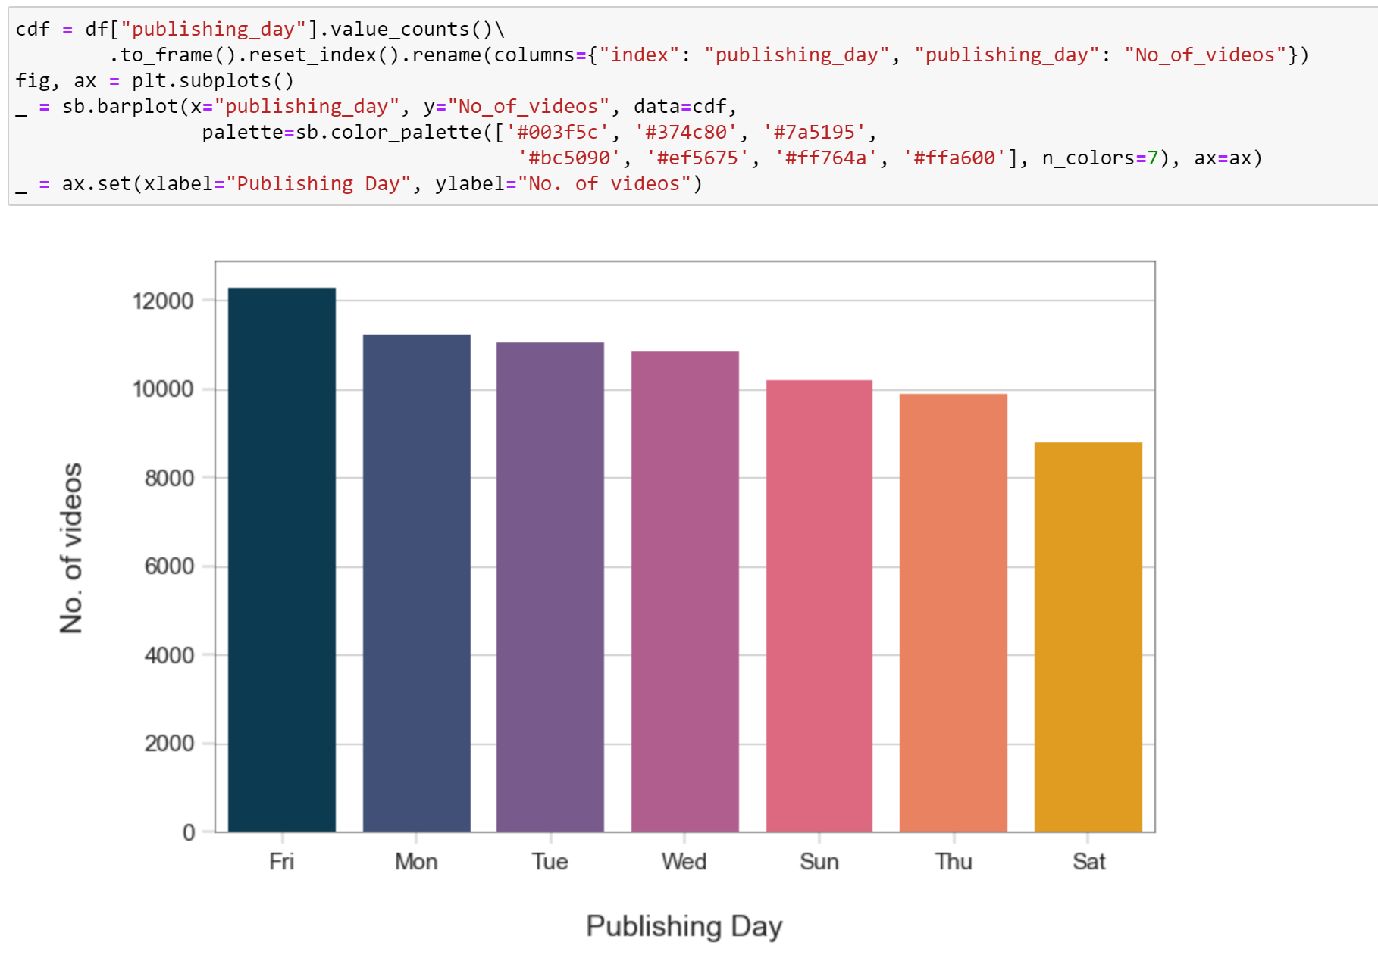
Non-numeric Variables (Publish day of week)
No clear distinction between trending videos and published day
Difficult to use this categorical variable for machine learning

Slide 10
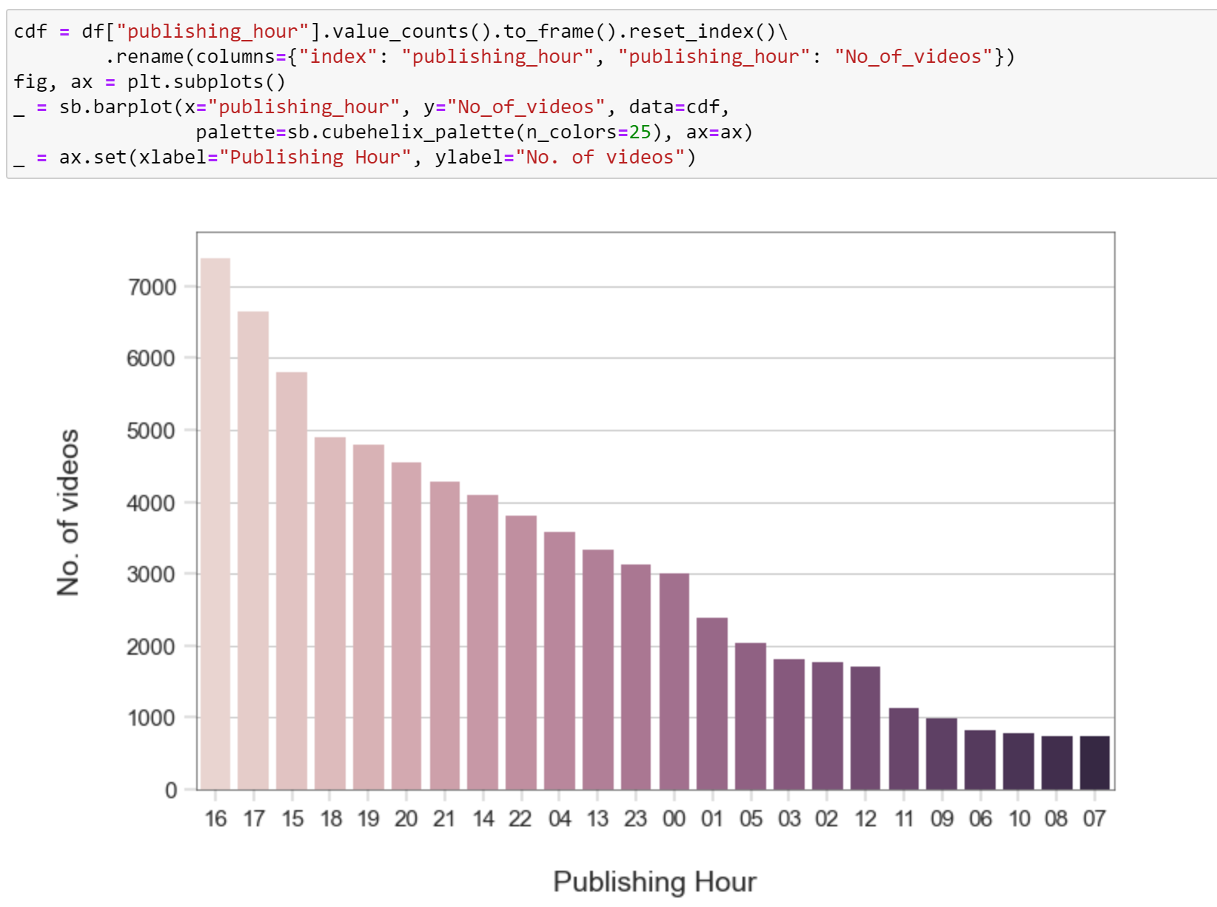
Non-numeric Variables (Publish time of day)
Clearest distinction between the publishing hour and its effect on number of trending videos

Slide 11
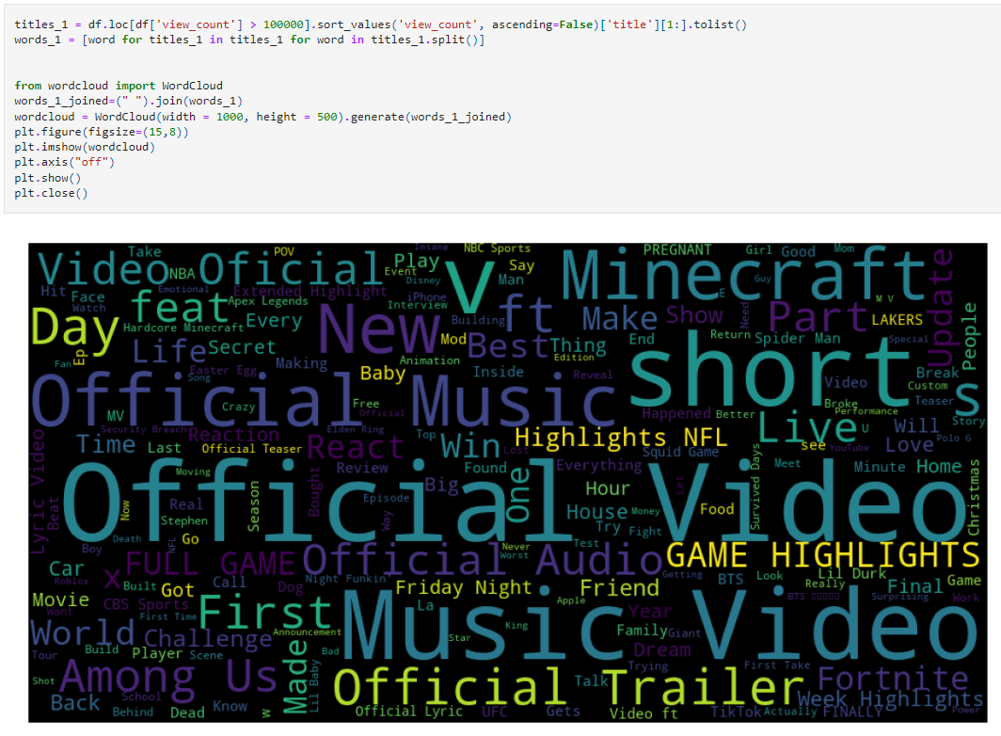
Non-numeric Variables (Popular title words)
Using word cloud, we identify popular title words that appear most repeatedly

Slide 12
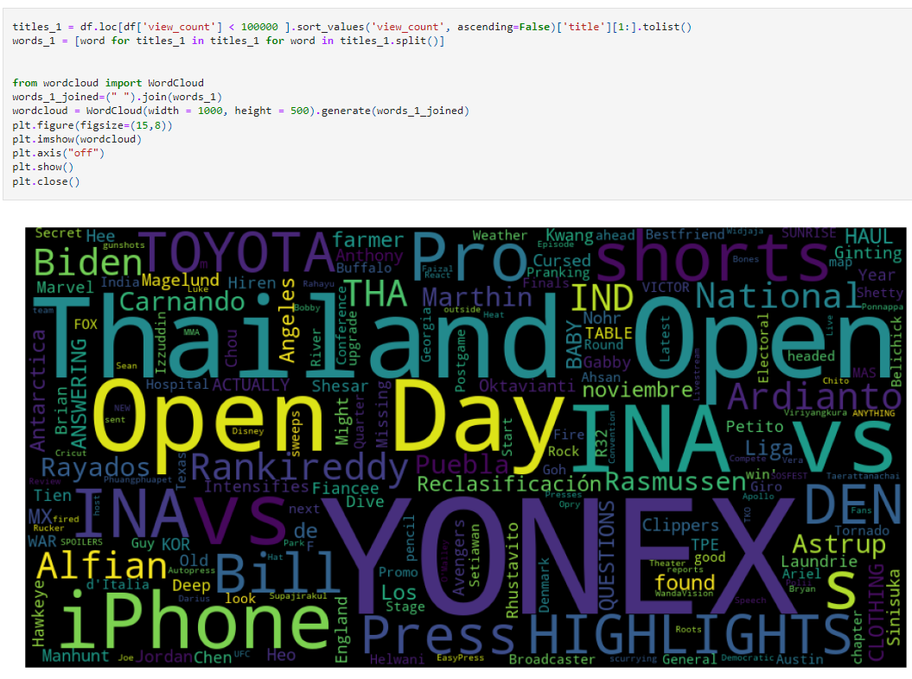
Non-numeric Variables (Unpopular title words)
– Using word cloud we are able to identify what are the common word for lower views

Slide 13
Data Preparation
Cleaning and extraction of the data

Slide 14
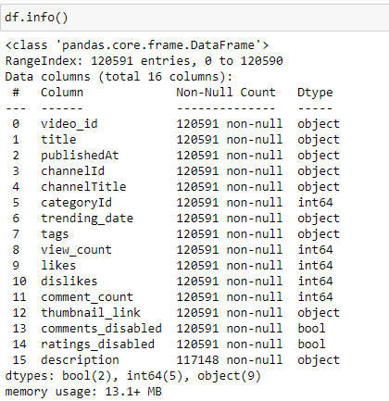
Our dataset
We can observe our dataset contains several variables which are numerical and non numerical

Slide 15
What we decide to clean out
channelID
channelTitle
tags
thumbnail_link
description
ratings_disabled

Slide 16
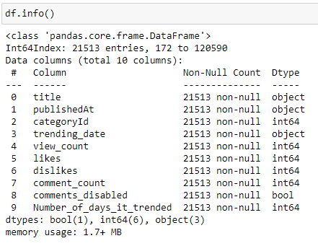
During cleaning
Used videoID to identify duplicated entries to know how many days it was trending, and removed the duplicates
We created a new column “Number_of_days_it_trended” where we inserted the days trended for each specific video
Important data to suit to our problem statement

Slide 17
Machine Learning
Multi Layer Perceptron &
Random Forest Tree

Slide 18
Features we
obtained
Our goal to predict
Train dataset
Target set
Views
Comments
Likes
Categories
Days that the video were trending

Slide 19
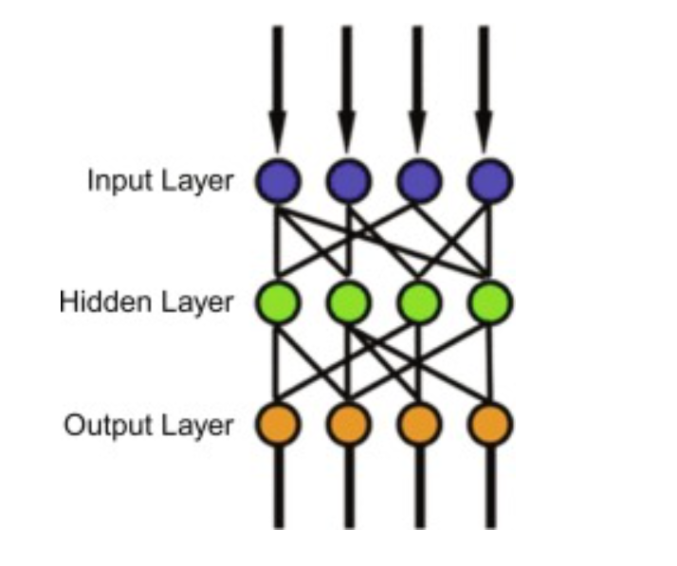
Multi-layer Perceptron
MLP is a neural network model which consists of at least 3 layers namely input layer, hidden layer and output layer
Input layer
- We will pass in the variables of our dataset
- Categories, Views, Comments, Likes
Hidden layer:
- Data will be trained with a back propagation
neural network with varying hidden layers
Output layer:
- We expect to generate days which the youtube
video will trend

Slide 20
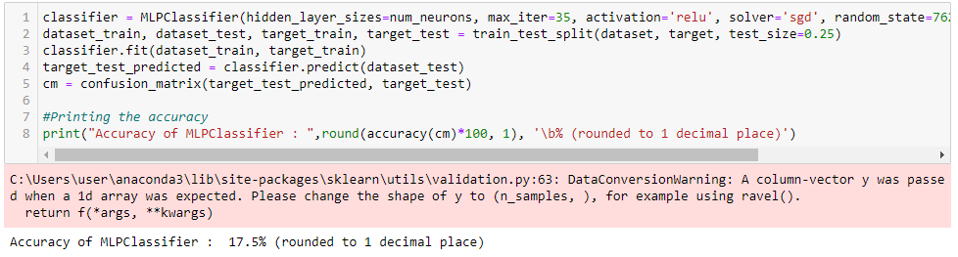
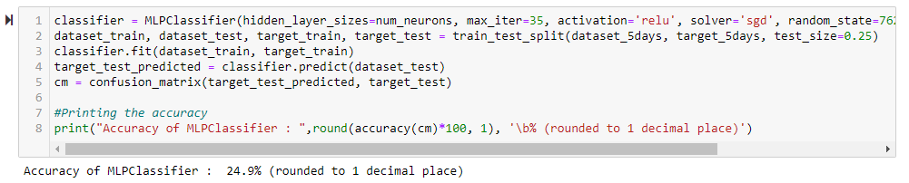
MLP with 100 hidden layers
Accuracy is considerably low despite changing out target spread

Slide 21
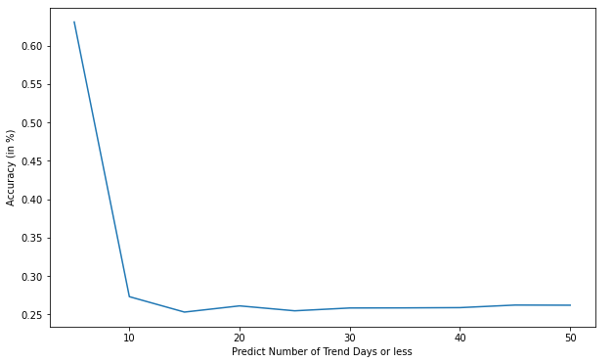

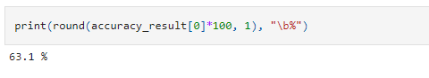
MLP with 10 000 hidden layers
Slightly higher accuracy previous
Higher accuracy as our target spread decreases
Predicting accuracy for trend days < 5 is over 60%

Slide 22

Random Forest Tree
It can handle large dataset with is good for our dataset where we have over 21000
Lower risk of misfitting
Works well with non-linear data

Slide 23
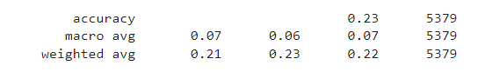
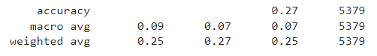
Random Forest (Model 1 )
Created with dataset that consist of videos that trended up to 46 days

Slide 24
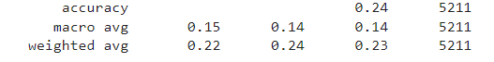
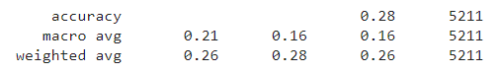
Random Forest (Model 2)
Created with dataset that consist of videos that trended up to 10 days

Slide 25
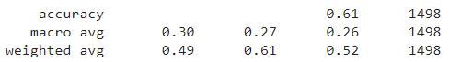
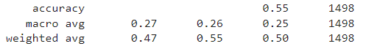
Random Forest (Model 3)
Created with dataset that consist of videos that trended up to 5 days
Best model out of all

Slide 26
Conclusion
Overall findings of the project

Slide 27
New things learnt
CloudWord as a new way to analysis the categorical data
Other packages like tqdm , json , request
Converted numbers from one dataset to names of a json file
Random Forest and MLP from SKLearn

Slide 28
Outcome
Accuracy : 63.1 %
Accuracy : 61.0 %
>
MultiLayer Perceptron
Random Forest Classification

Slide 29
Did it solve original problem?
YES it did!
The MultiLayer Perceptron machine learning is able to predict it more accurately
However, it could only be trained to be more accurate for predicting the number of days the video trends for up to 5 days!

Slide 30
Insights and Recommendations
Possibility to explore different machine learning algorithms to predict
Ability to utilise thumbnail of a youtube video as dataset for machine learning
Using a Convolutional Neural Network to do photo classifications

Slide 31
Contributions
TAN KAI BOON - Data Extraction & Cleaning + Data Visualization
TAN KOK ANN JEFF - Random Forest + Data Visualization
LIM JIA EARN - Multi-Layer perceptron + Data Visualization

Slide 32

THANK YOU

